Slide 1
Connect Gadgetron to MR scanner
An interactive session for IceGadgetron
Hui Xue
NHLBI, NIH
June 2020

Slide 2
In this session
Overview of IceGadgetron
Ice simulation and debug IceGadgetron/Gadgetron
On scanner demo
FAQ and discussion

Slide 3
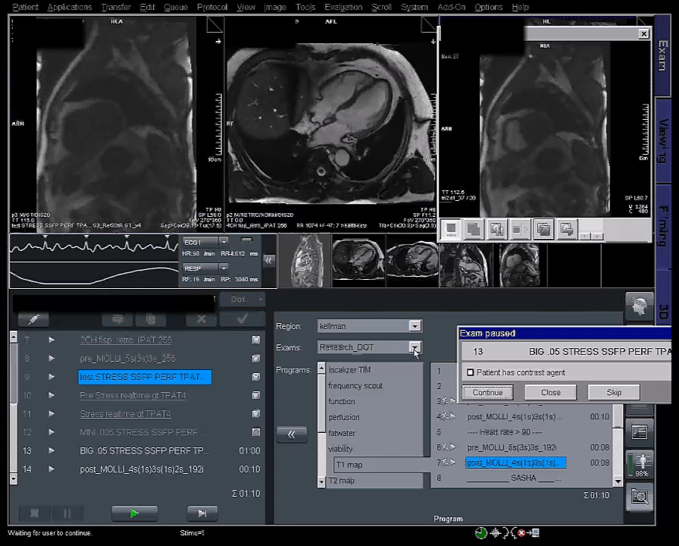
Why the IceGadgetron is needed
Because it enables clinical imaging using Gadgetron
100% software solution
Gadgetron processing is transparent to end user

Slide 4
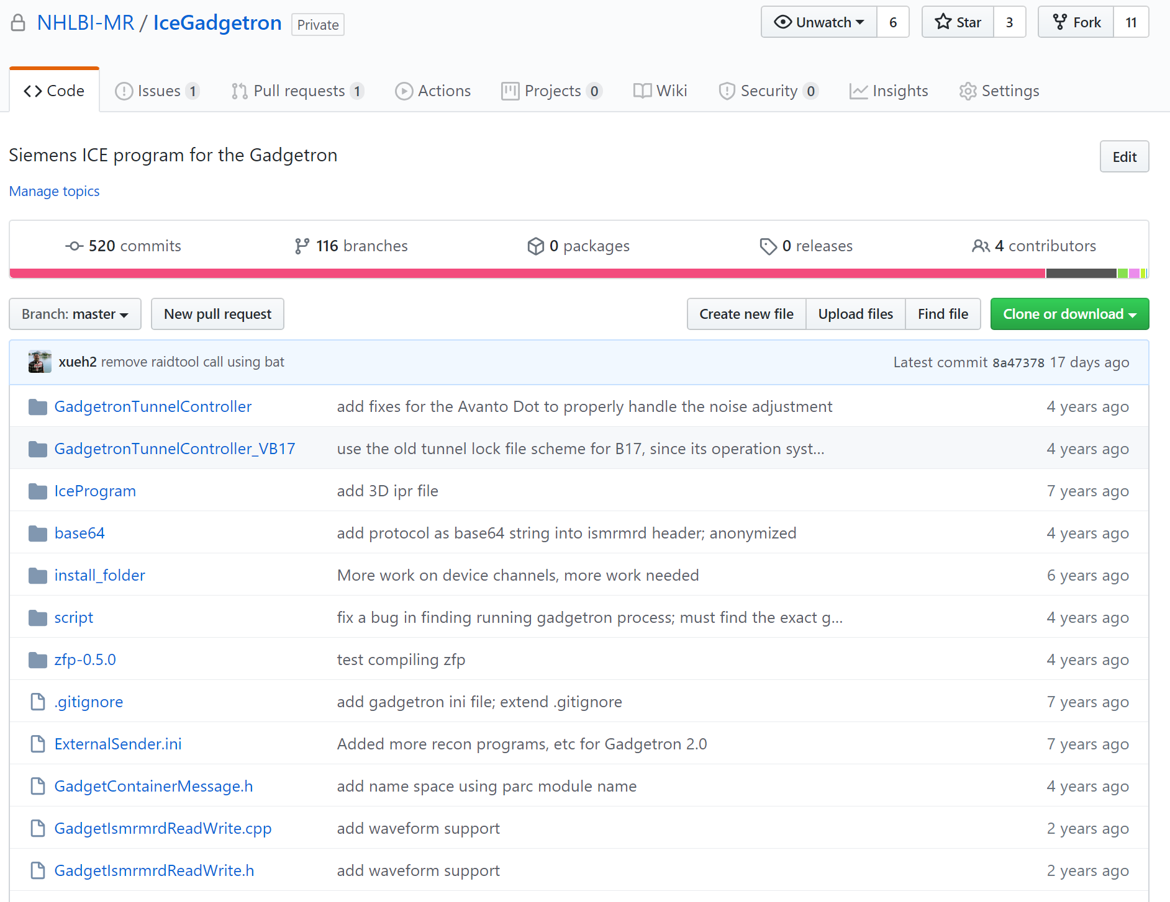
Where is IceGadgetron and how to access
https://github.com/NHLBI-MR/IceGadgetron
Available for Siemens Customers with research agreement
Contact hui.xue@nih.gov
PR welcome!

Slide 5
What IceGadgetron does
Vendor provided reconstruction
Raid
Data
labelling
Recon
Decorator
ImageSend
IceGadgetron changes the default chain
Raid
Data
labelling
Emitter
Recon
Injector
Decorator
ImageSend
Data out
Images back
Gadgetron

Slide 6
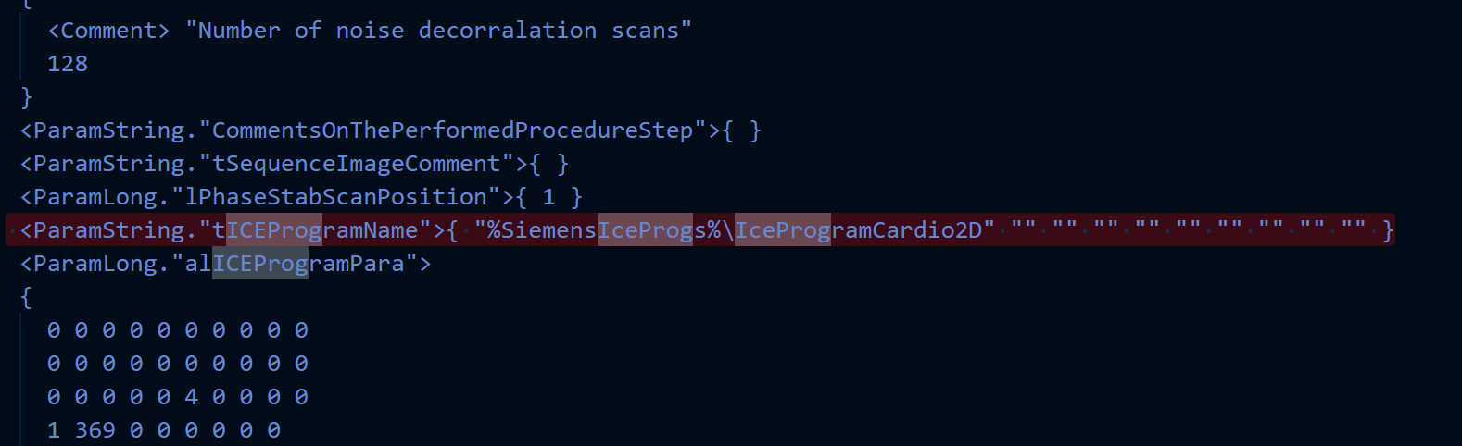
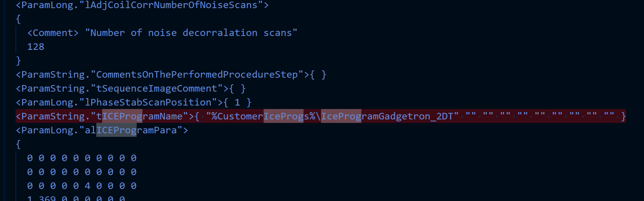
Set IceProgram of a sequence
Determined in sequence by set ice program name

Slide 7
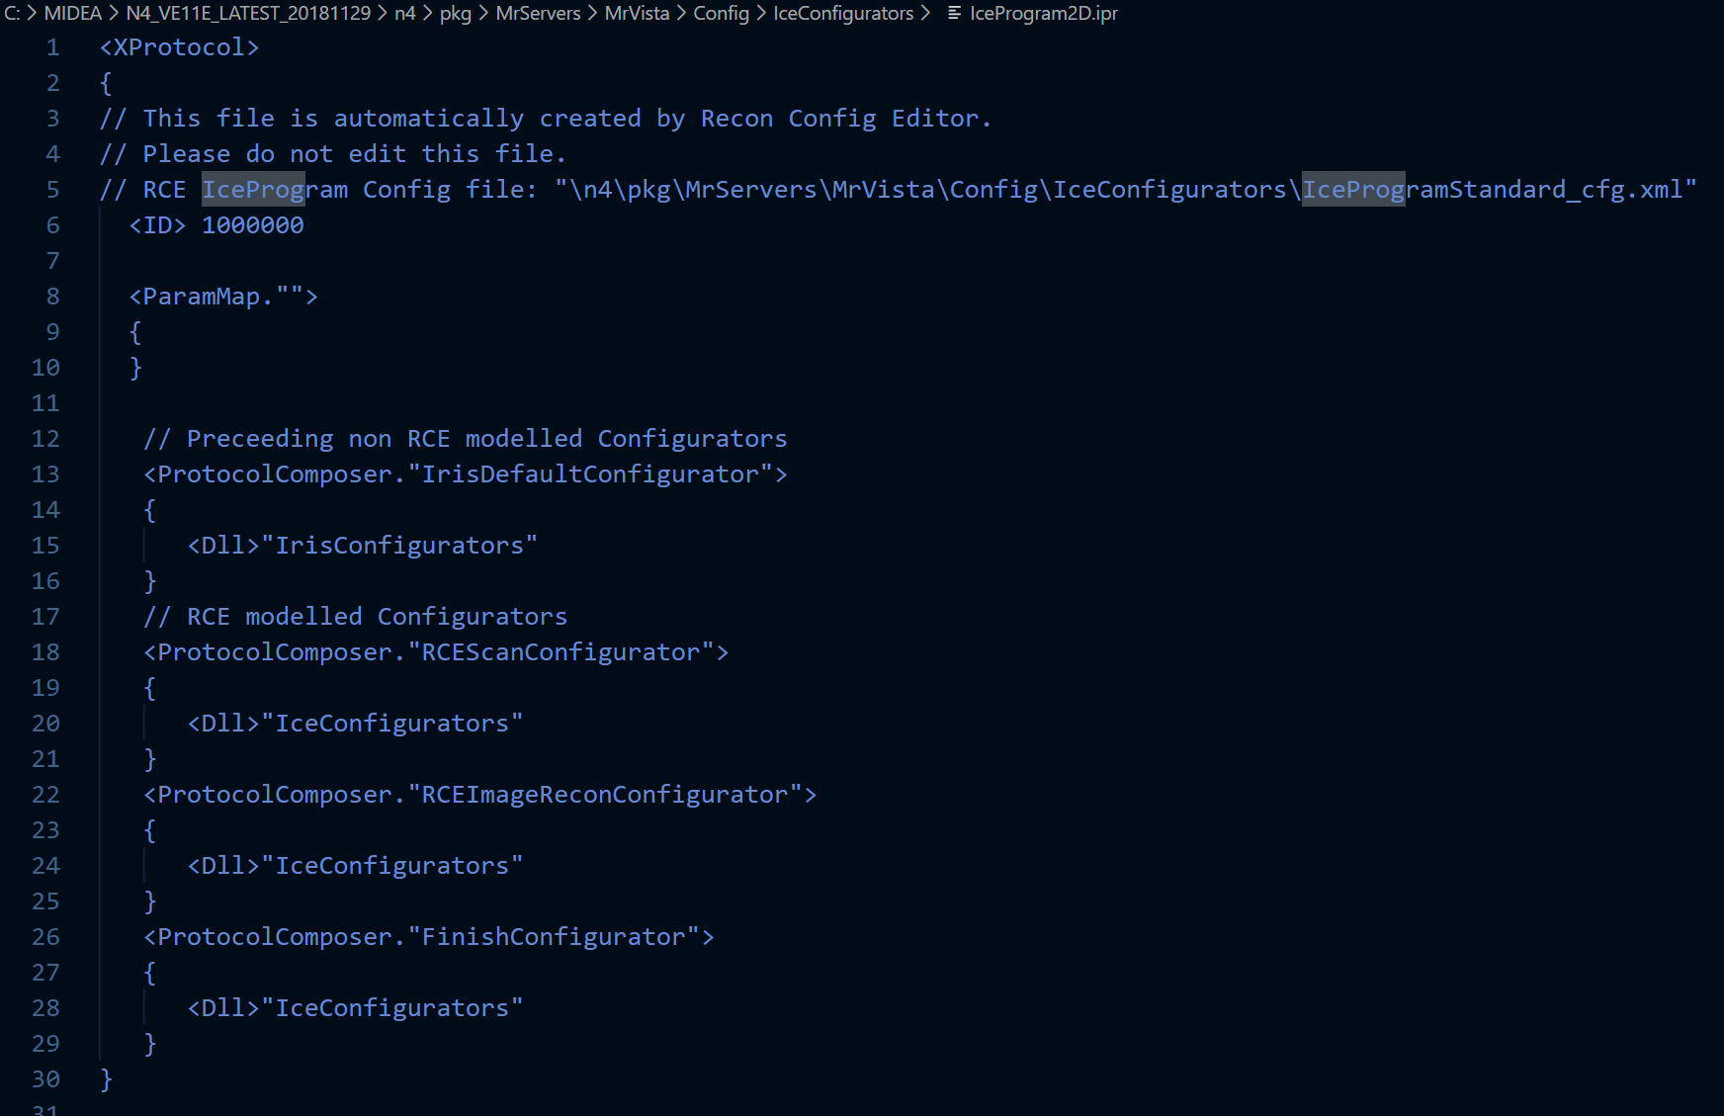
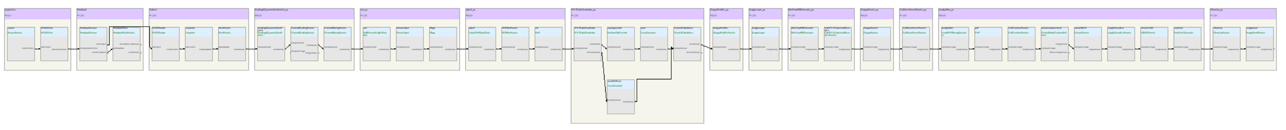
Default IceProgram ipr

Slide 8
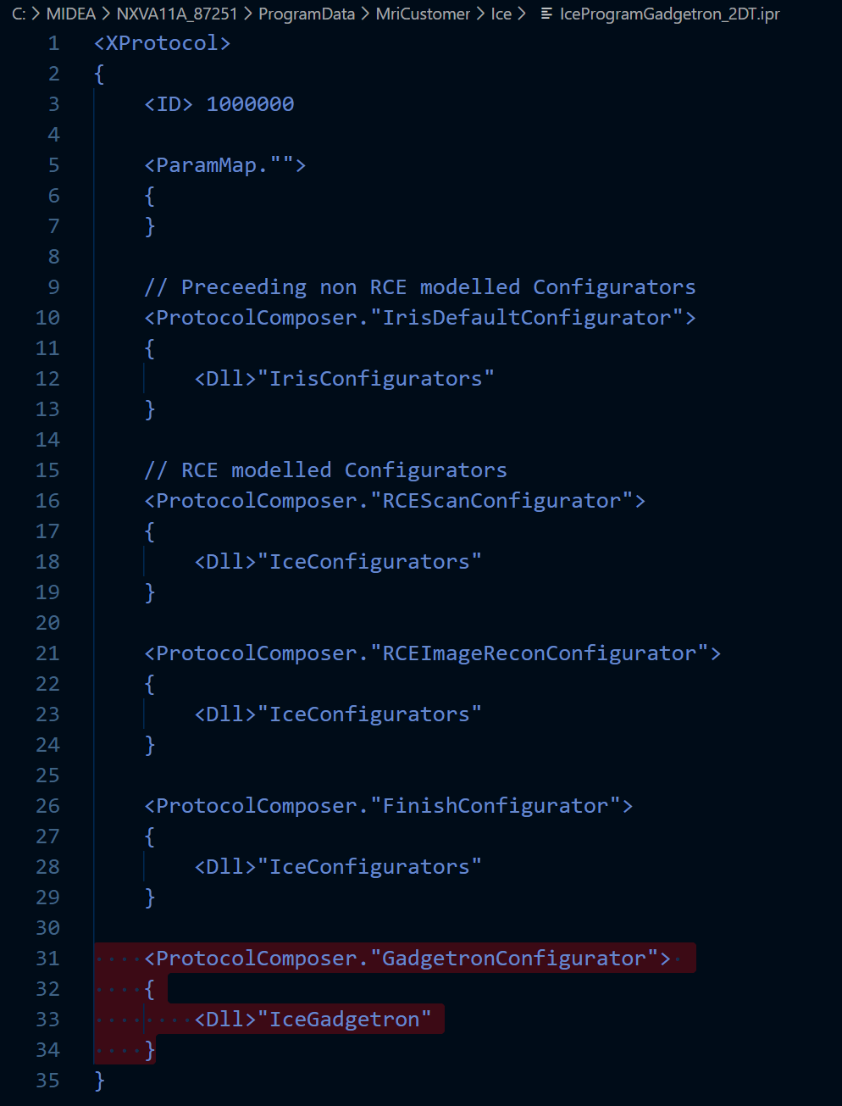
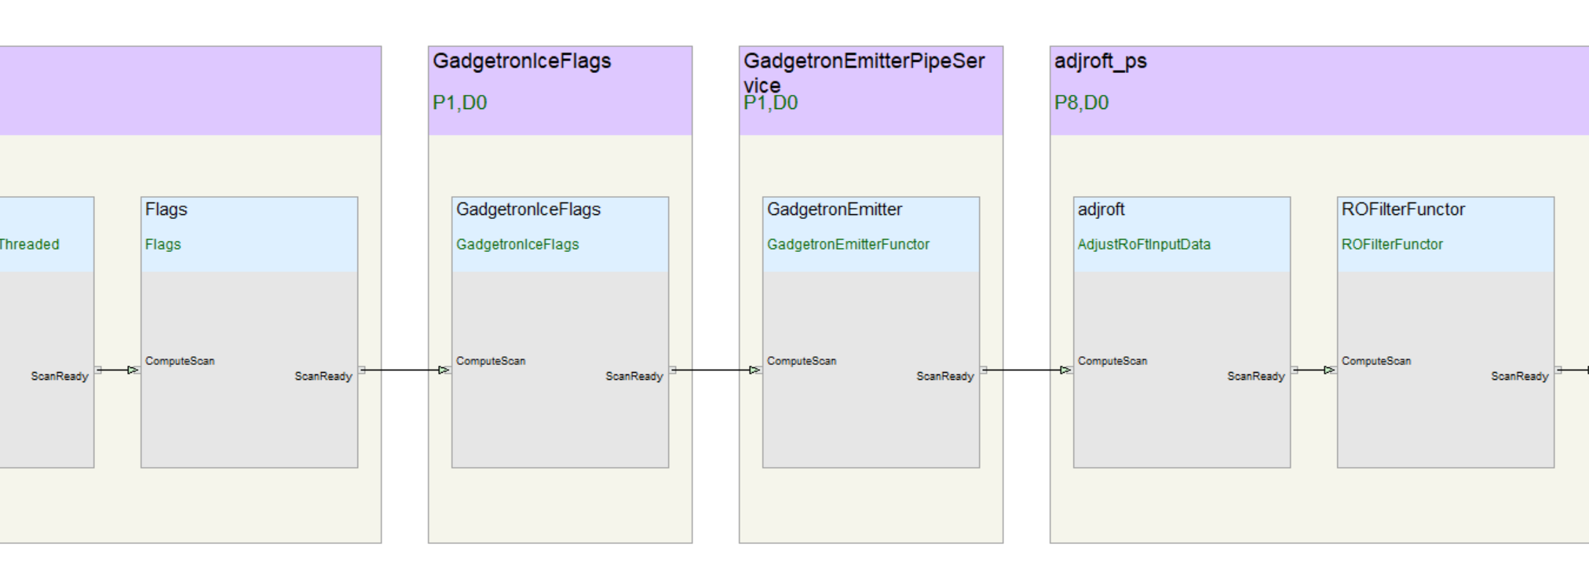
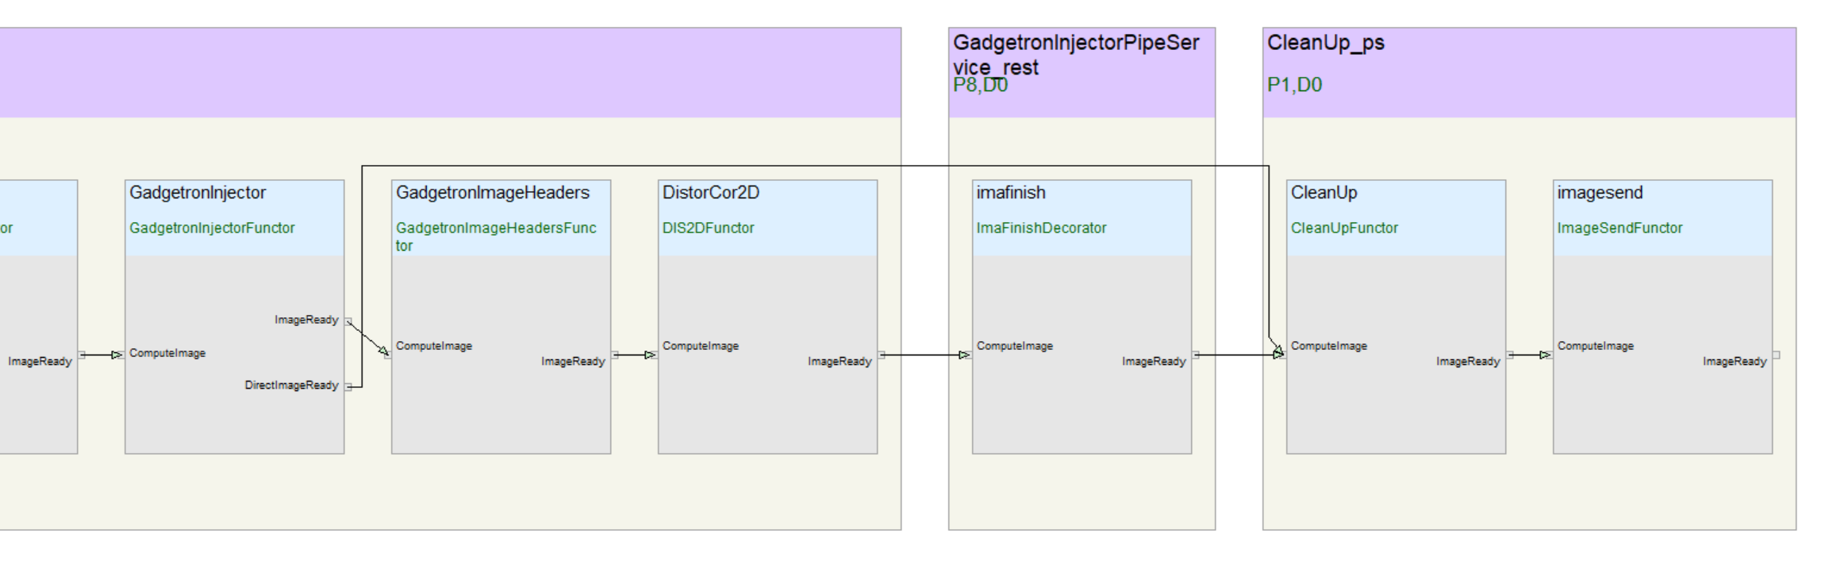
Add IceGadgetron

Slide 9
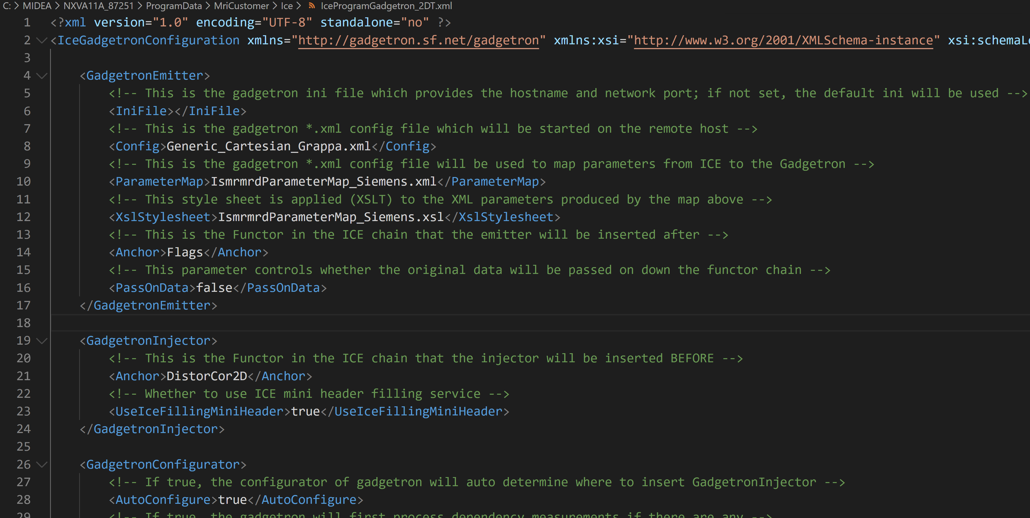
What is IceProgram xml: parameters to control recon chain

Slide 10
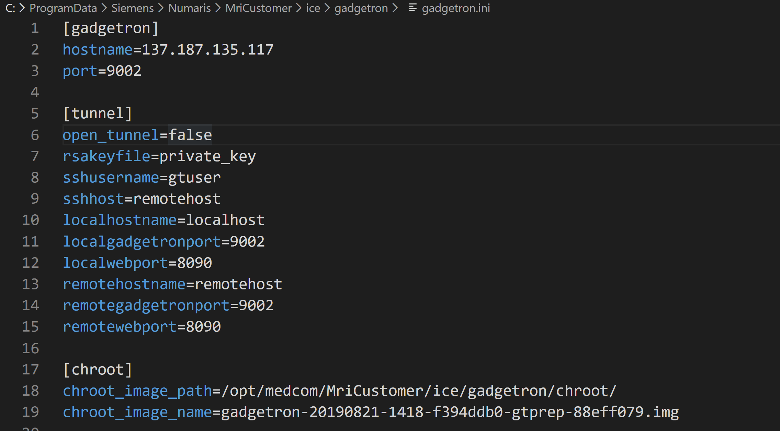
What is gadgetron.ini: parameters to control where to send data

Slide 11
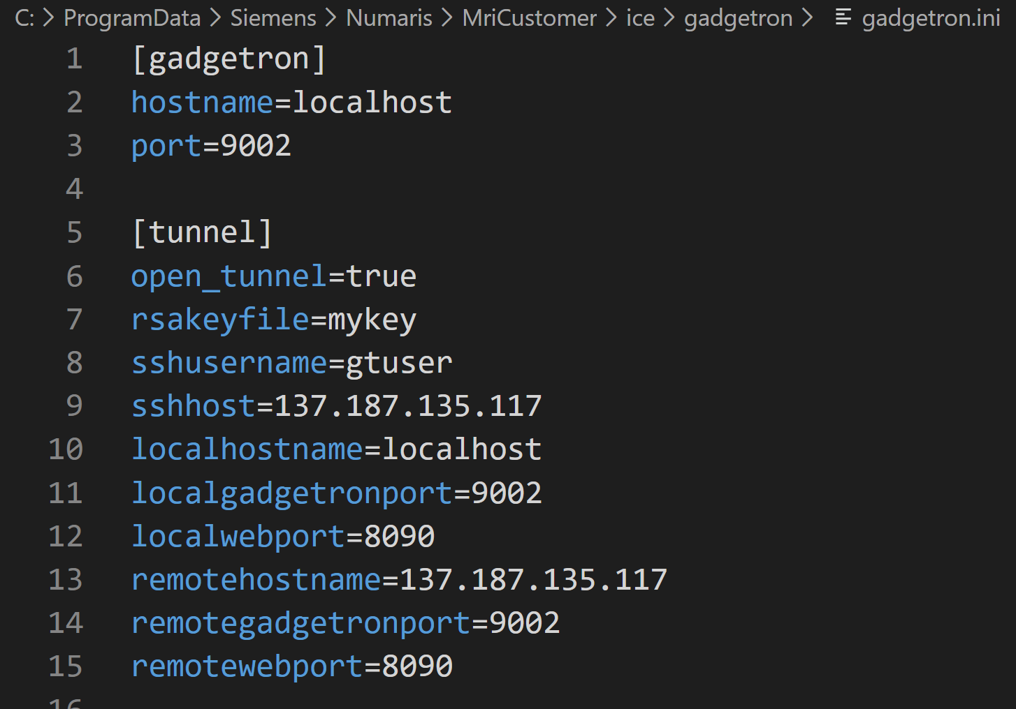
What is gadgetron.ini: use tunnel
ssh –L localhostname:localgadgetronport:remotehostname:remotegadgetronport –i rsakeyfile gtuser@sshhost
ssh –L localhost:9002:137.187.135.117:9002 –i rsakeyfile gtuser@137.187.135.117
Flexible connections to gadgetron servers

Slide 12
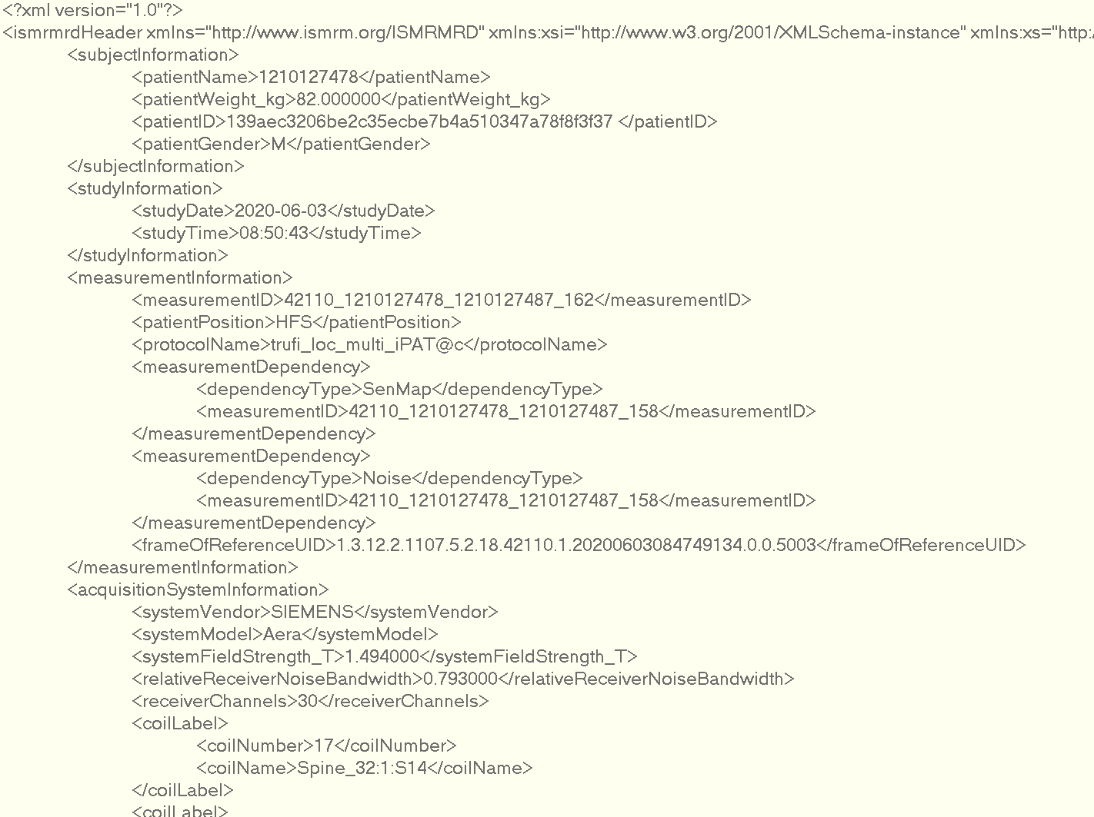
Handle the dependent measurements
A MR scan can depend on previous scans
Sensitivity maps
Pre-scan/surface coil correction data
Noise scans

Slide 13
Handle the dependent measurements
IceGadgetron always first send dependency scans to Gadgetron first, if possible
In GadgetronConfigurator
In GadgetronEmitter
has dependent scans?
has dependent scans?
yes
yes
Find the file id of
dependent scans
Convert dependent scan to
MRD format
Dump the dependent scans
MriCustomer/ice/dependency
Send dependent scan
to Gadgetron
Notice the Emitter to
process dependencies
Other steps …
Other steps …

Slide 14
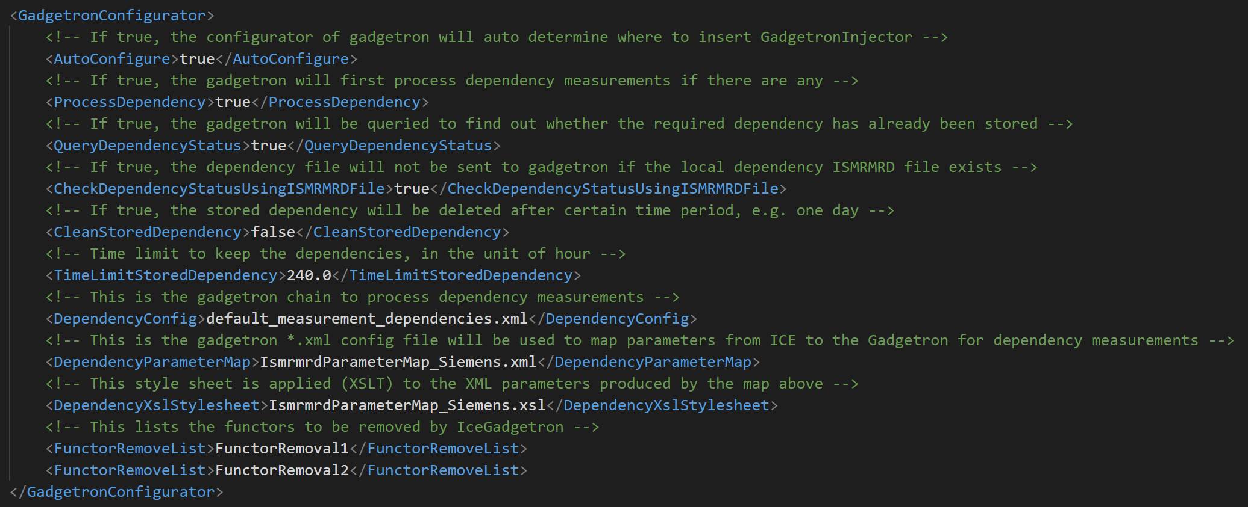
Handle the dependent measurements
In the IceProgramGadgetron xml, there are a few options about dependent scans

Slide 15
Demo session IceGadgetron in IDEA simulation
On IDEA side
icestart –r –dicom
icesimu test.dat
change gadgetron.ini
check logviewer
Live demo …
On localhost
On remote server
Inline debug
On Gadgetron side
Start Gadgetron
Watch log

Slide 16
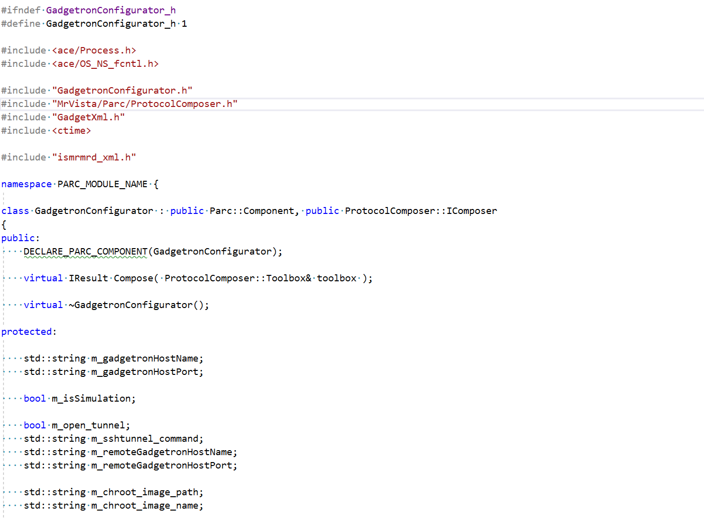
Configurator
GadgetronConfigurator.h/cpp
Check baseline
Parse seq parameters
Parse gadgetron.ini
Establish ssh connection
if needed
Determine where to insert
Emitter and Injector
Create and insert
Emitter and Injector
functors
…

Slide 17
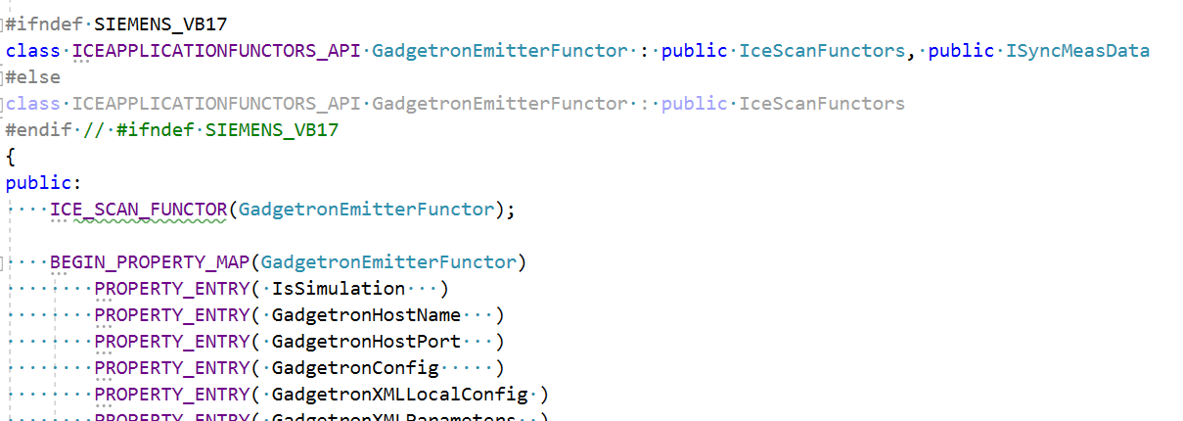
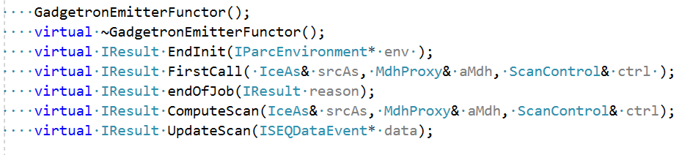
Emitter
If running Gadgetron on mars,
start gadgetron
Process dependent scans
Convert every
readout line to MRD format
Send MRD acquisition
to gadgetron
…

Slide 18
Emitter : ComputeScan
IResult GadgetronEmitterFunctor::ComputeScan(IceAs& srcAs, MdhProxy& aMdh, ScanControl& ctrl)
{
…
// declare MRD acquisition
// create gadgetron acq message and send it out
GadgetContainerMessage<GadgetMessageIdentifier> *m1 =
new GadgetContainerMessage<GadgetMessageIdentifier>();
…
GadgetContainerMessage<ISMRMRD::Acquisition>* m2 =
new GadgetContainerMessage<ISMRMRD::Acquisition>();
m1->cont(m2);
// fill MRD acquisition header from Mdh
std::vector<int> dimensions(2);
dimensions[0] = aMdh.getNoOfColumns();
dimensions[1] = aMdh.getNoOfChannels();
ah->version = ISMRMRD_VERSION;
ah->measurement_uid = aMdh.getMeasUID();
ah->scan_counter = aMdh.getScanCounter();
ah->acquisition_time_stamp = aMdh.getTimeStamp();
ah->physiology_time_stamp[0] = aMdh.getPMUTimeStamp();
ah->number_of_samples = aMdh.getNoOfColumns();
ah->active_channels = aMdh.getNoOfChannels();
ah->center_sample = aMdh.getKSpaceCentreColumn();
ah->position[0] = aMdh.getSliceData().sSlicePosVec.flSag;
ah->position[1] = aMdh.getSliceData().sSlicePosVec.flCor;
ah->position[2] = aMdh.getSliceData().sSlicePosVec.flTra;
// fill MRD acquisition data array
size_t data_length = ah->number_of_samples*ah->active_channels;
a->data_ = new float[2*data_length];
…
memcpy(a->data_,coherentAs.calcSplObjStartAddr(),data_length*2*sizeof(float));
…
// send MRD acquisition to socket
connector_->writer_task().svc2(m1) != 0
…
}

Slide 19
Emittor: for sync data (ECG, RESP, Grad …)
IResult GadgetronEmitterFunctor::UpdateScan(ISEQDataEvent* data)
{
#ifndef SIEMENS_VB17
// Check sync data type
SEQData& syncdata = data->getSEQData();
int32_t len = syncdata.getLength();
std::string id = std::string(syncdata.getID());
bool is_pmu = false;
bool is_pmu_learn = false;
bool is_gradient = false;
if (id.find("PMULearnPhase") != id.npos)
{
is_pmu = true;
is_pmu_learn = true;
}
…
if(is_pmu || is_pmu_learn || is_gradient)
{
uint32_t* pmu_data = reinterpret_cast<uint32_t*>(syncdata.getData());
// convert sync data to MRD waveform
std::vector<ISMRMRD::Waveform> wav;
GadgetContainerMessage<GadgetMessageIdentifier> *m1 = new GadgetContainerMessage<GadgetMessageIdentifier>();
m1->getObjectPtr()->id = static_cast<ACE_UINT16>(GADGET_MESSAGE_ISMRMRD_WAVEFORM);
GadgetContainerMessage<ISMRMRD::ISMRMRD_Waveform>* m2 = new GadgetContainerMessage<ISMRMRD::ISMRMRD_Waveform>();
m1->cont(m2);
size_t num_total_samples = pWav->head.channels * pWav->head.number_of_samples;
m2->getObjectPtr()->head = pWav->head;
m2->getObjectPtr()->data = new uint32_t[num_total_samples];
memcpy(m2->getObjectPtr()->data, pWav->data, num_total_samples * sizeof(uint32_t));
// send wave form to Gadgetron
if (connector_->writer_task().svc2(m1) != 0)
…
…
}
#endif // SIEMENS_VB17
return I_OK;
}

Slide 20
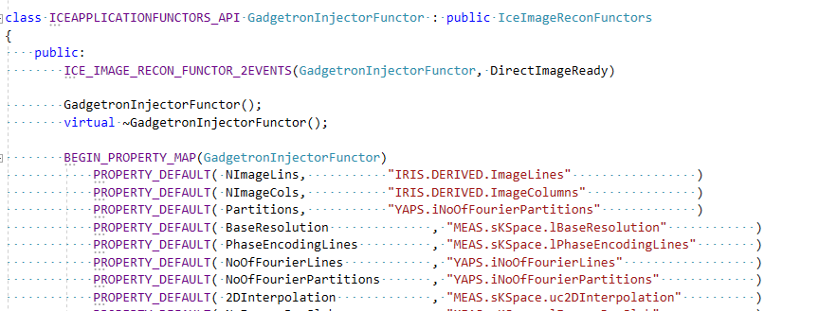
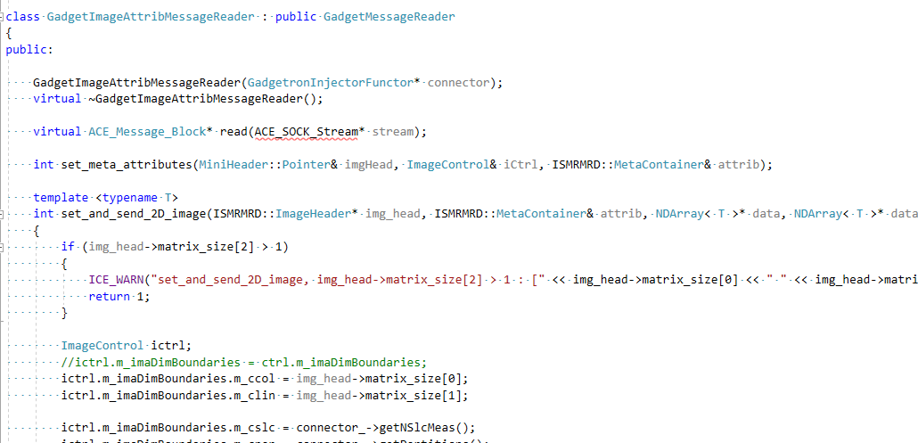
Injector
GadgetronInjectorFunctor.h/cpp
GadgetMessageReaders.h/cpp
Configure and
start ImageReader
Monitor socket for
incoming images
Convert MRD image
to ICE object
Pass image to next functor
…

Slide 21
Demo session IceGadgetron on scanner
Installation and installer
Run scanner on MARS
Change gadgetron.ini to use external server
Change gadgetron.ini to use ssh tunnel – a preview for Gadgetron AI demo
To reproduce these demo:
Installer
Chroot image
To create chroot, call gadgetron/docker/create_chroot_from_image
Data, AI model, scripts etc.

Slide 22
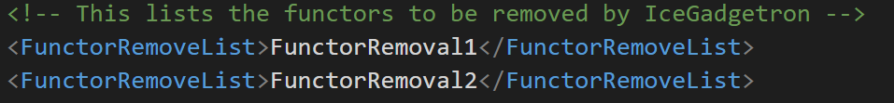
How to configure the ICE in general
For a new application,
Check default
function chain
Common places to insert:
For emitter, Root, Flags,
For Injector, DistorCor2D/3D, ImaFinish
Determine places to insert
Emitter and Injector
Whether to remove functors
Ice simu and check logs
Edit IceProgramGadgetron, edit xml file …
Scanner test
…
On scanner inline debug is possible

